Slide 1
Risk Management and Forecasting Interest Rate
Mrunal Mahakala

Slide 2

Business problem
Our Bank Oriental bank of commerce is facing challenges on handling and managing loan portfolios which includes handling risk of customer defaults for active customers in data base
Our bank also faces challenges while trying to enhance customer satisfaction and attract more customers to take their loans.

Slide 3

Goals to achieve
The first goal is to Analyze historical customer data and classify the active customers if a customer is getting default or not at the point of customer’s observation. we would like to mitigate risk based on the default status of the customer.
The second goal of the project is to forecast customers’ specific interest rates by using time series forecasting based on the historical interest rate, HPI index, FICO score, and the LTV ratio of the customer. With this banks can offer a competitive loan structure for customers to maintain customer satisfaction.

Slide 4

Dataset Overview and Preprocessing
The dataset contains multiple observations with the same ID, so aggregated the data based on ID to effectively analyze the dataset.
Partitioned the active customer separately.
Derived term of loan indicates maturity terms from first day and length_completed indicates the length loan term completed.
The dataset after transformation contains 50000 records out of that 12 NA values in LTV ratio which were handled.

Slide 5

Classification of customer defaulting
For classification, the data was Partitioned into 40, 30, 30 split.
Classification is done on historic customers and deployed on the active customers
For the model , have implemented various models such as logistic ,step wise forward, stepwise backward,decision tree with trials 6 and 10

Slide 6
Classification of customer defaulting (cont..)
Model | Accuracy | Sensitivity | Specificity
Logistic Regression | 78.23 | 0.6426 | 0.8638
Step wise Forward | 78.29 | 0.6436 | 0.8642
Step wise Backward | 78.29 | 0.6436 | 0.8642
C5.0 Tree | 77.77% | 0.6738 | 0.8372
C5.0 Tree with Trial 6 | 78.73 | 0.6566 | 0.8636
C5.0 Tree with Trial 10 | 78.76% | 0.6563 | 0.8642
The C5.0 tree has better sensitivity at 0.6738 which tells how correctly it classifies the important class
After the model performed on Holdout set to see if there is any over fitting to train data and got sensitivity of 0.68 and accuracy of 80%.

Slide 7
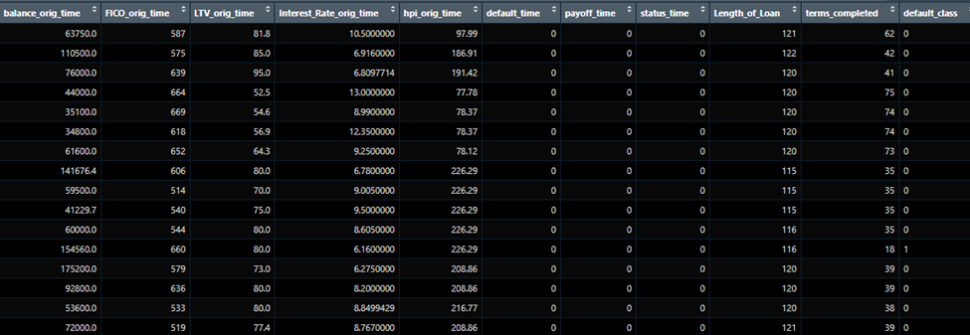
After the Model is performed on the Active Customer in the bank dataset

Slide 8

Time series forecasting the Interest rate
The second goal of the project is to create a forecast for the average interest rate of a new customer's loan in the future loan.
From the original dataset grouped the origin time and averaged the interest rate also filtered zeros because might skew the average.
Missing periods are completed and NA values are imputed with the mean of neighbor values.

Slide 9
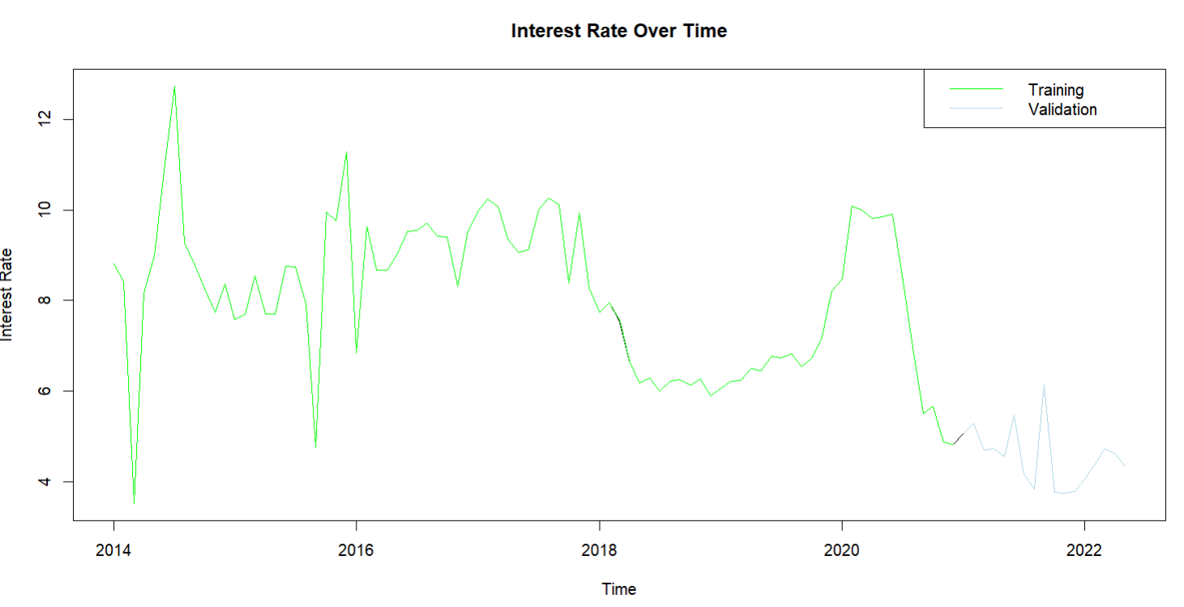
Time series forecasting the Interest rate
Time series is partitioned into train and validation, the training data contains data from 2014 to 2021 and validation contains 2021 Jan to 2022 May.
Performed many models SNAIVE, Holtz-winter model with ETS, and ARIMA model

Slide 10
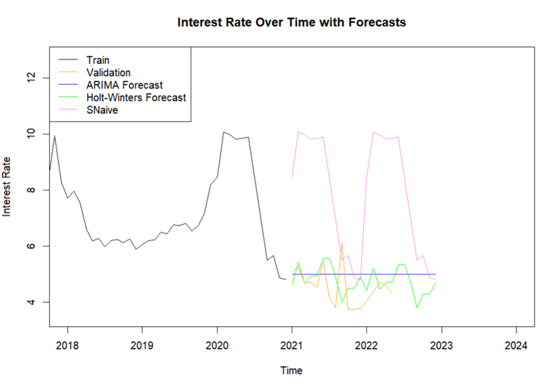
Time series continued
Model | ME | MAE | RMSE
SNaive | -3.8421 | 3.9191 | 4.2609
ETS | -0.2848 | 0.6181 | 0.8263
ARIMA | -0.4487 | 0.6831 | 0.7888
We could see that ARIMA performs better with RMSE 0.7888 for test set compared to others like ets with validation RMSE of 0.8263 and snaive at 4.2609.
with the help of ARIMA model we need to forecast the future data with full data to forecast next year’s forecast for interest rate.

Slide 11
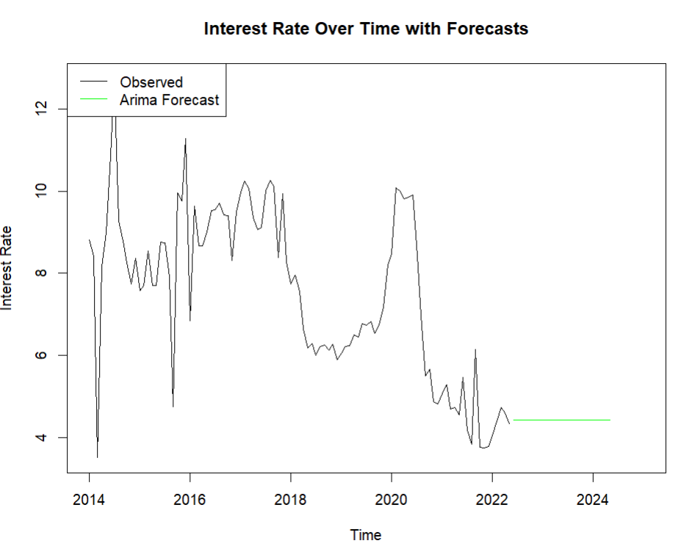

Slide 12
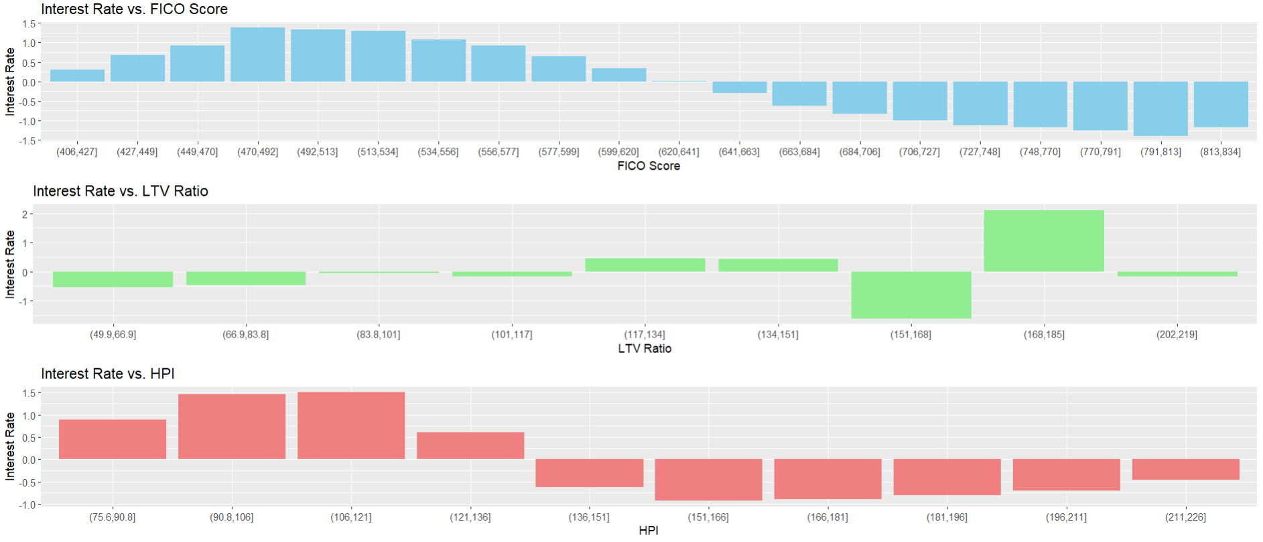
Recommendations
By classification output the banker is to mitigate the risk by contacting the customer to review and revoke the loan to increase maturity period terms or in the worst case prepare for auctioning the property of the customer.
From the time series forecast the outputs are intended to customers having average FICO,LTV ratio.
So, to mitigate the risk of default for new customers change the interest rate based on the percentage change in average of FICO, LTV, and HPI.

Slide 13

Thank you

Slide 14
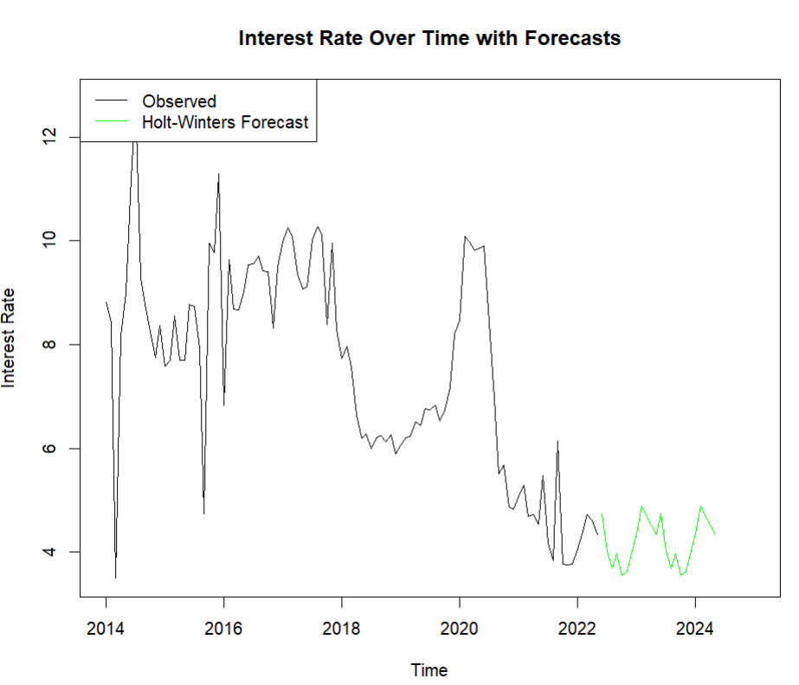
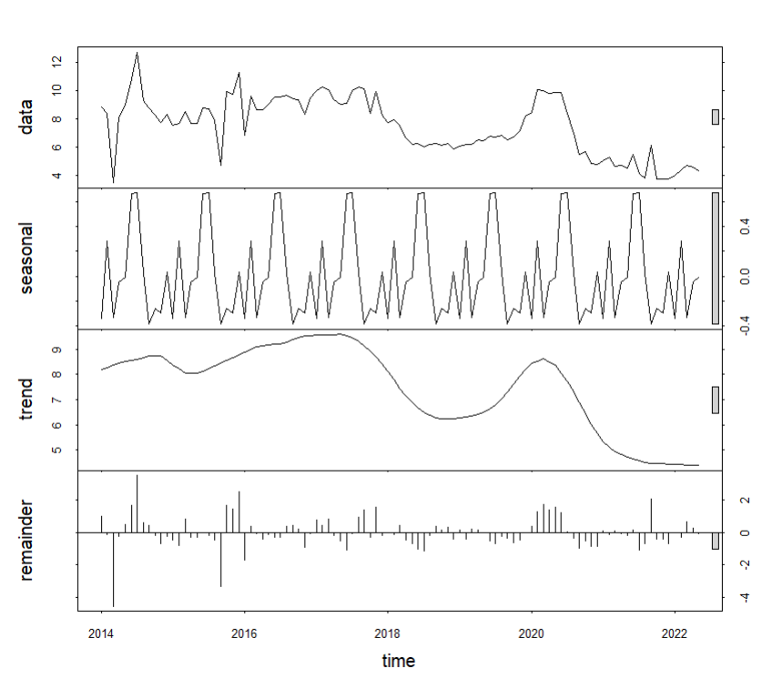
EXTRA PLOTS

